Slide 1
ES6

Slide 2
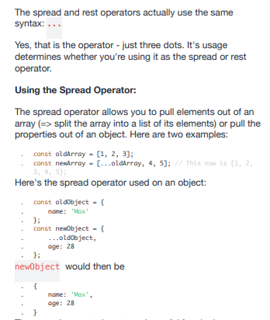
Spread and rest parameter

Slide 3
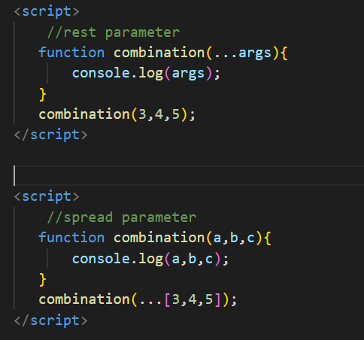
Rest And Spread Parameter

Slide 4
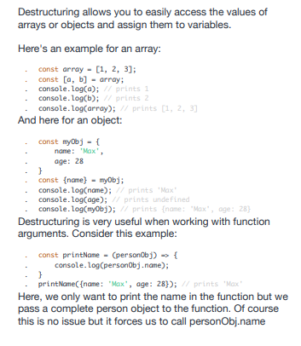
Destructing

